Slide 1
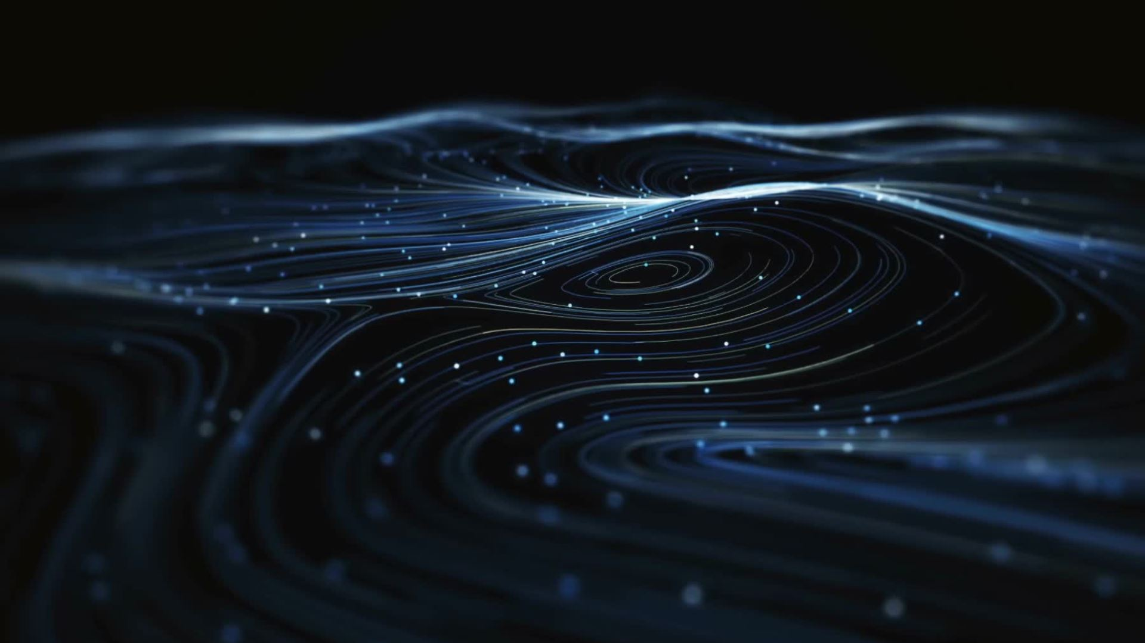
Gravitational Waves
Presented By: Ember Boicey & Everett Helm

Slide 2
Motivations For Exploring Gravitational Waves
Understand the exchanges in energy of merger events
Further develop understanding of general relativity
Quantify the mass and density of black holes and neutron stars
It's super cool!

Slide 3
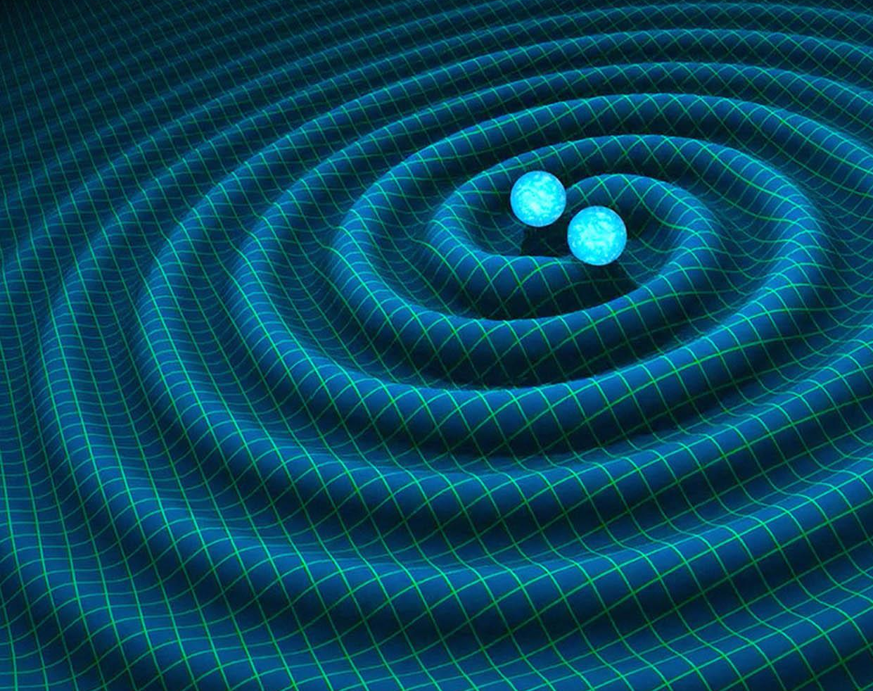
Science Behind Gravitational Waves
Accelerating orbits of large bodies create ripples in time space much like a stone in a pond.

Slide 4
Processes Used
Lasers at LIGOS are stretched and compressed by Gravity waves
Data is recorded and filtered
Data is then compared to other LIGOS Detectors to confirm the event

Slide 5
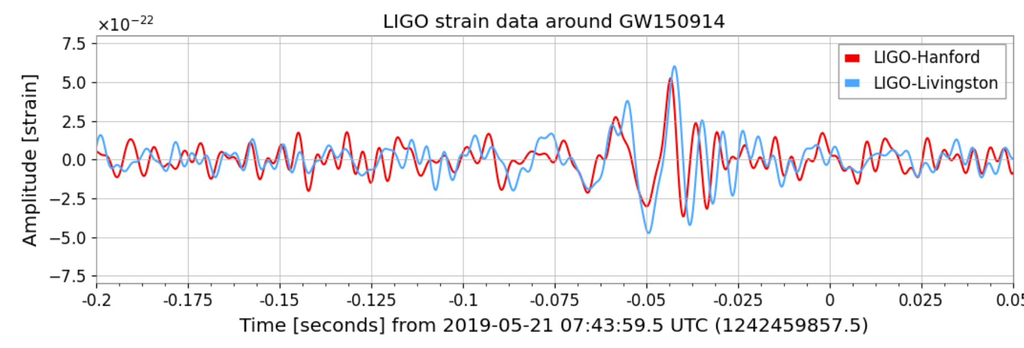
Analysis
Data is compared to confirm the event
Further studied for similarities to other events
Gauge size of the merging bodies

Slide 6
Hypothesis & Conclusion
Develop General Relativity Understanding
Continue to improve testing equipment
Optimize data collection systems

